Slide 1
Opinion Mining and Summarization of Hotel Reviews
Group 8
Apurv Rathore (A17006)
Arun Chaudhry(A17007)
Devender Kumar(A17010)
Shikhar Dhwaj(A17030)

Slide 2
Agenda
The objective
Goals
Process Pipeline
Insights and Conclusion

Slide 3
Objective
To derive business insights for top 5 Five Star Hotels in Mumbai using TripAdvisor reviews.

Slide 4
Goals
Obtain over 1250 reviews for Top five 5-start using Web Scraping from TripAdvisor.com
Pre-process the text data and identify important aspects using Exploratory Analysis
Assign sentiment to reviews, and extract information on different aspects
Generate insights

Slide 5
Process
Sentiment Analysis
03
Web Scraping
.
01
02
Data Cleaning

Slide 6
Process Pipeline
Data Collection
Scraping Hotel Reviews, Rating and Date
Data Cleaning
Word Tokenization
Case Conversion
Removing Special Characters
Expanding Contractions
Removing Stop words
Word Cloud for information extraction
Sentiment Analysis
Aspect specific Analysis based on the sentiment

Slide 7
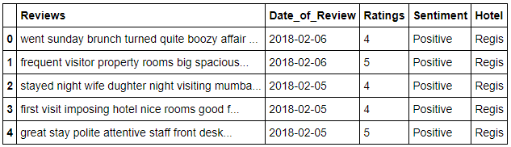
Data Collection
Scraping Hotel Reviews, Rating and Date

Slide 8
Data Cleaning
Word Tokenization
Case Conversion
Removing Special Characters
Expanding Contractions
Removing Stop words
Notes:
# is.lower
# string.punctuation
# contrations_dict

Slide 9
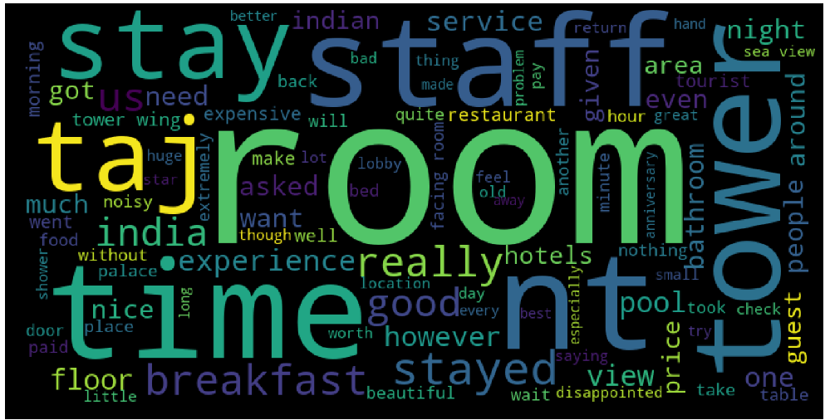
Word Cloud

Slide 10

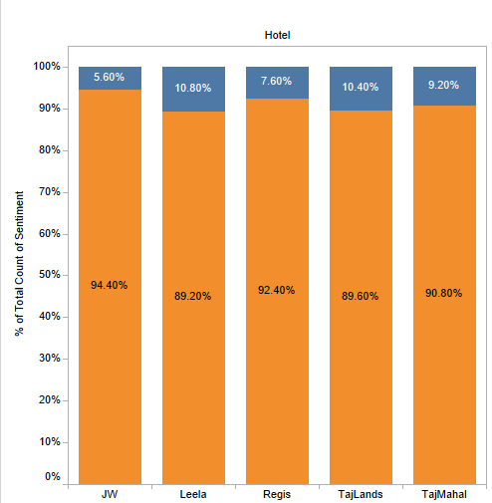
Sentiment Analysis
Assign reviews with higher and lower ratings, positive and negative sentiment, respectively.
Extract aspects from exploratory analysis for each sentiment
Carry out Aspect based analysis to generate insights

Slide 11
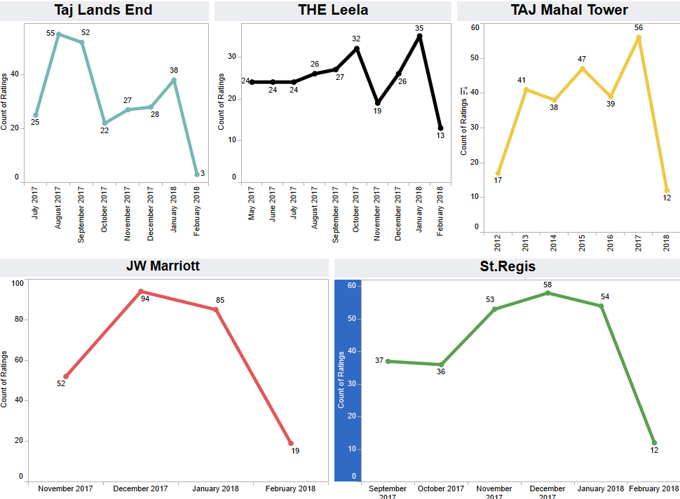

Slide 12
Insights and Conclusions

Slide 13
Insights and Conclusions: St. Regis Hotel
Restaurant hygiene and facilities like air conditioning
Optimization and regulation of Payment collection system for in-hotel services.
Train and evaluate service staff more frequently
Notes:
Food is good in all of top hotels. There are a lot of options in the menu. The buffet is also really attractive. But with some hotels, there is a need to work on hygiene and facilities like air conditioning of the restaurant. Area of the restaurant is too big for the current air conditioning.
Local come to try food from different part but location of the hotel is a problem. The area ia pretty congested
Payment collection channels need to be regulated and optimised. There has been a lot of issues regarding overcharging for services like Airport transfers, extra bedding etc. The foreign customers have been overcharged for airport transfers. Also, there is a need to regulate payment collection system since there has been a lot of instances where there was a problem with payment confirmation when the mode of payemt was credit or debit card.
To keep the service staff coherent with the services of the hotel. To maintain a good co-ordination between the staff members.

Slide 14
Insights and Conclusions: JW Marriott Hotel
Room allocation management system requires improvement
Special training and evaluation for staff at Hotel Front Desk.
Poor Airport transport service
Notes:
Which often leads to increased checkin and check out time leading to dissatisfaction among the employees
For the last point, they probably needs to hire better manage their cars and drivers

Slide 15
Insights and Conclusions: Taj Lands End Hotel
Disturbance from the in-Hotel Events and renovation process
Frequent Quality checks for food, and actions on complaints and feedback
Dynamic Pricing for Sea facing rooms to meet high demand
Notes:
Renovation time should be adjusted as per the convenience of the customers
Quality of breakfast: oily, and cold
Sea view rooms are high in demand, so they should be priced dynamically

Slide 16
Insights and Conclusions: The Leela Hotel
Rooms and Furniture require renovation and repair
Increase the provision of basic toiletries, and water bottles
Revamp the food menu, fix prices and conduct frequent quality checks
Hire more management to keep the staff under check
Notes:
Below average food. Over priced. Work on their menu
Staff used credit card details without customers consent
Lack of basic toileteries and water bottle
Requires renovation of rooms and furniture

Slide 17
Insights: Taj Mahal Tower
Need to upgrade Air Conditioning system and washrooms
Install bird protectors to maintain hygiene of the Swimming Pool
Train the management to keep the staff’s behavior under check
Notes:
Discrimination among visitors on the basis of class of stay
Upgrade washrooms and air conditioning
Overpriced for the level of services
Swimming pool

Slide 18
THE END

